Slide 1
Data Innovation Challenge
Managing Healthcare Costs in Singapore
Presented by
Aung Myint Thein
7 May 2014

Slide 2
Methods used and the finding (formula)
Most interesting thing
Insights
Age groups
Bill Category
16 Clusters
Most interesting thing
Values to business
Improvements

Slide 3
Logistic Regression
Linear Regression
Clustering

Slide 4
The most interesting thing about the solution
Not dependent on disease types
Age, Bill category, Type of Hospital (13), Duration of stay,
Year of admission

Slide 5
Easy implementation
Machine learning, iteratively the model can improve itself
More detailed and refined clusters
Less processing time, faster decision making

Slide 6
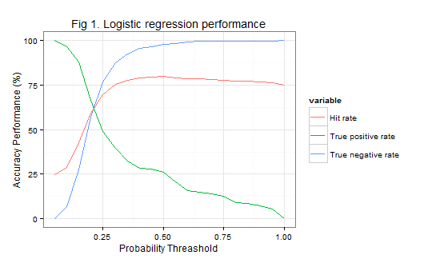

Slide 7
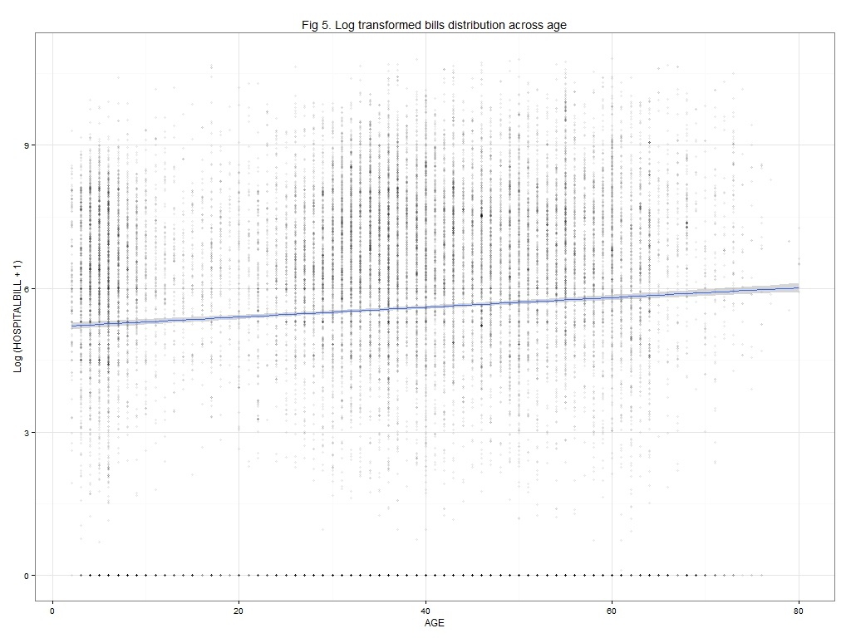

Slide 8
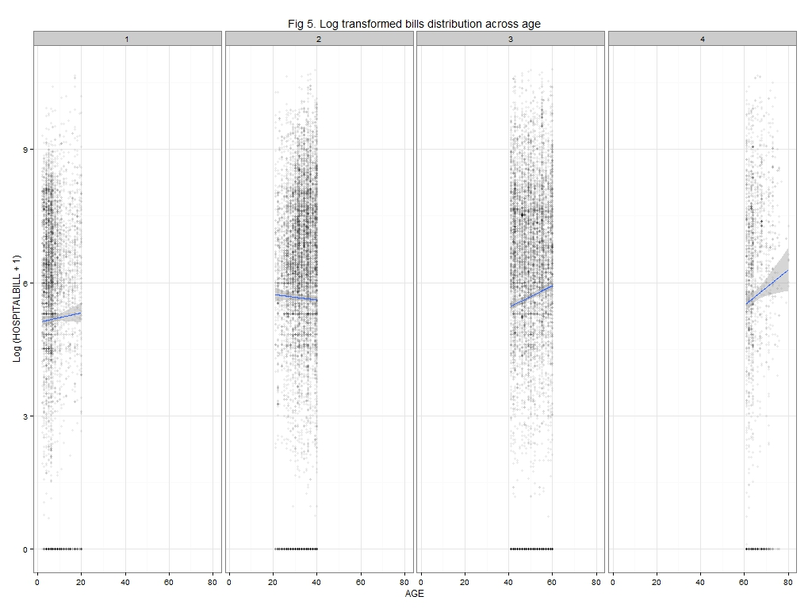

Slide 9
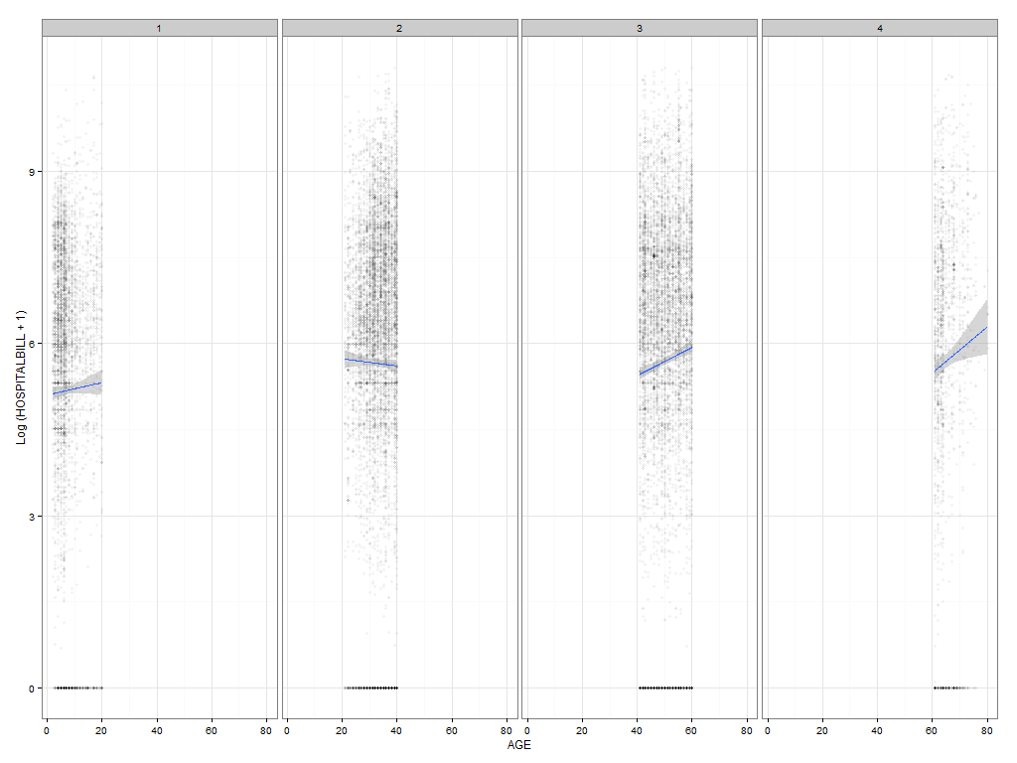

Slide 10
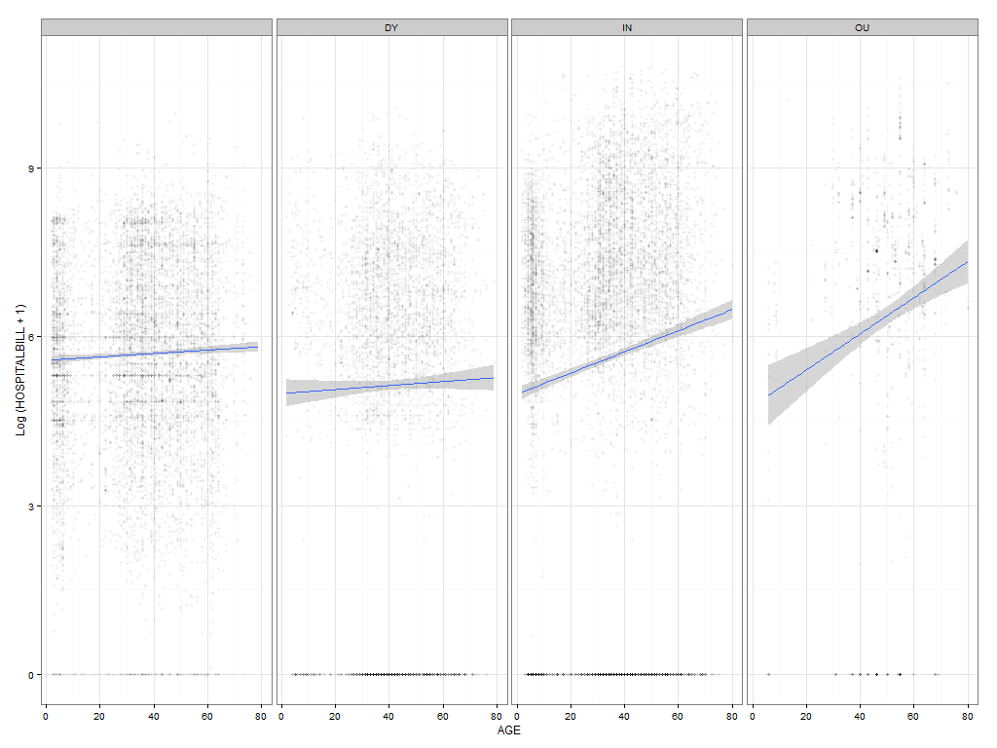

Slide 11
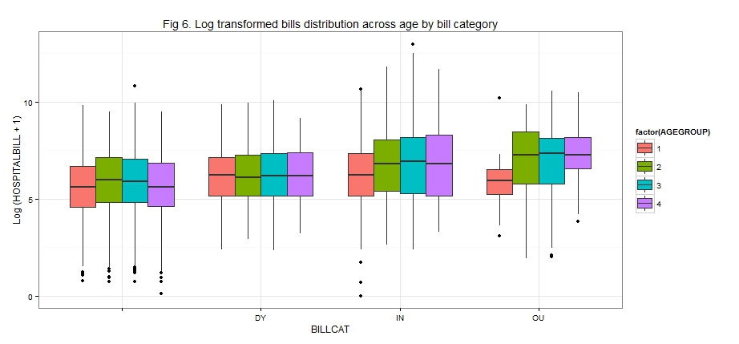
Clustering based on age and bill category

Slide 12
Description of each item in the bills
Average per day for each hospital
More accurate classification of hospitals from experts
More systematic clustering
Robust

Slide 13
Q n A

Slide 14
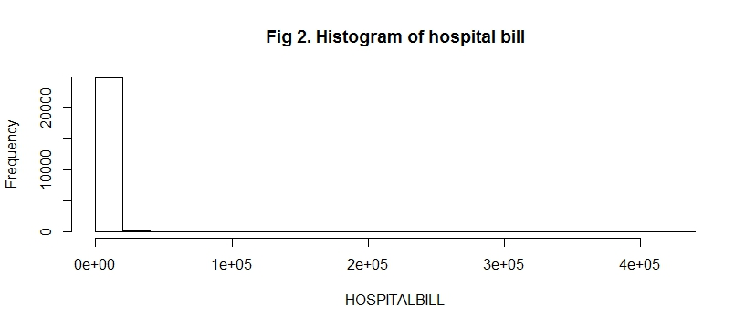
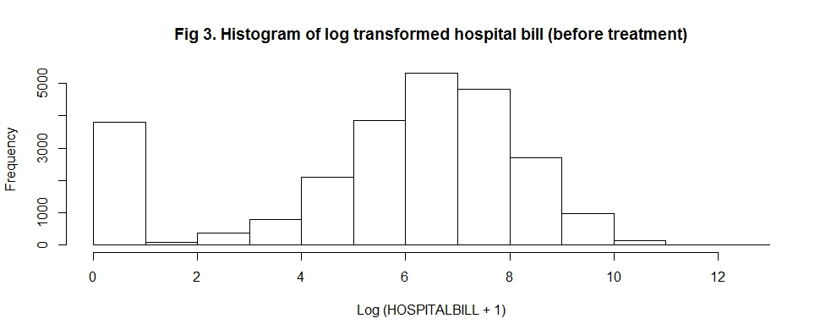
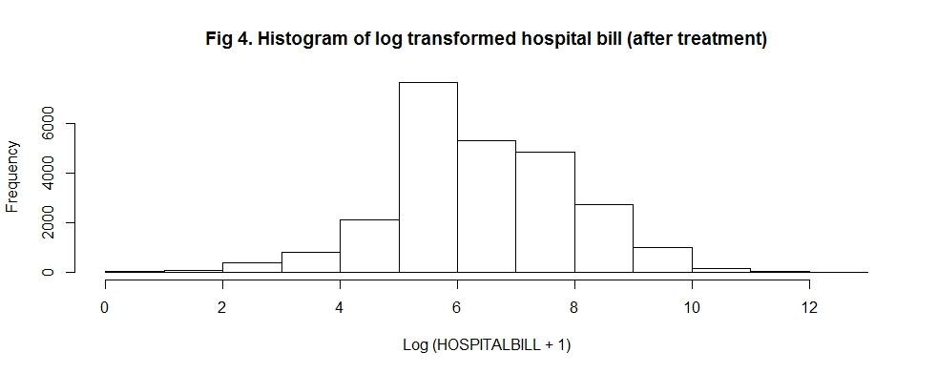

Slide 15
 |  | DY | IN | OU
1 | 2012 | 387 | 3055 | 48
2 | 3190 | 2031 | 3534 | 198
3 | 2781 | 2140 | 2957 | 677
4 | 674 | 480 | 594 | 250

